Slide 1
1
Business Activities and the Role of Accounting

Slide 2

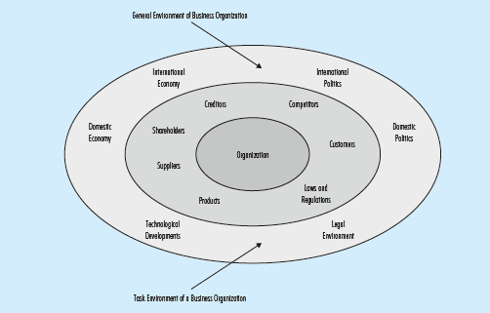

Environment of a Business Organization

Slide 3

Aim of the Accounting Information
accounting is an information system that measures, processes and communicates financial information of an economic entity to the decision makers
  economic entity is an economic organization that acts independently
  business entity is an economic entity that sells goods or provides services

Slide 4
Accounting Information System
Main building blocks
  identification and measurement
  recording
  communicating outcome by financial statements and other financial reports
Characteristics
  Relevant- meets the needs of decision makers
  Reliable - trustable
  Comparable – among companies and among different periods for the same company

Slide 5
Accounting Information System
Analyze Transaction
Record
Classify
Summarize
Report
Audit
Financial Statement Analysis
Bookkeeping

Slide 6

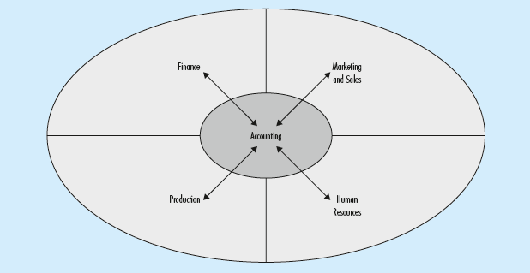




Business Information System Components

Slide 7
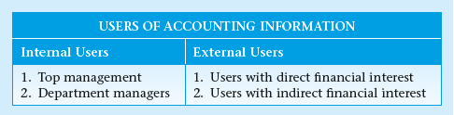


Users of Accounting Information
creditors ; investors
government ; regulatory agencies ; labor unions; financial advisors; brokerage firms; auditors; lawyers; consumer groups; and academicians
executive officers

Slide 8
Users of Accounting Information
decision makers - the users of the accounting information
To whom is the business accountable?
What is it accountable for?
What is the role of accounting in this accountability?

Slide 9

Business Goals and Strategies
Business Goal
is the target of a business organization towards which all efforts are directed
the goal of profit maximization or profitability
the goal of liquidity
Business Strategies
are the means to achieve the set goals

Slide 10
Business Entity Forms
Sole Proprietorship
Partnership
Corporation

Slide 11
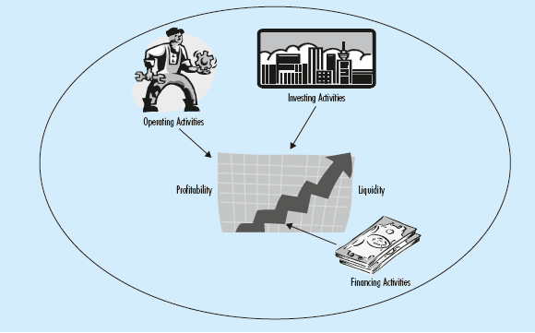
Business Activities

Slide 12
Financing Activities
initially needs funds to setup a business
in later periods to run operations and to grow
obtaining such funds either from external or internal sources
 | creditors | shareholders
Funds obtained from: | loans (debt) | capital
Funds provided to: | payment of interest | payment of dividends
 | repayment of debt

Slide 13
Investing Activities
Spending the funds obtained effectively and efficiently
involve purchase and sale of
  buildings, machinery or other investment instruments such as government bonds, treasury bills
extending loans to other companies
are expected to contribute directly or indirectly to the profit maximization and solvency goals of the business

Slide 14
Operating Activities
involve the daily activities of the entities to run the business
include
  sales and marketing of the goods sold and services provided
  production
  purchasing merchandise and inventory items
  managing human resources
effective and efficient management of operating activities needed to achieve profitability and liquidity

Slide 15

Primary Financial Statements
Income Statement
Statement of Financial Position (balance sheet)
Cash Flow Statement (or Statement of Cash Flows)
Statement of Changes in Equity

Slide 16
Income Statement
summarizes the revenues and expenses of an entity for a certain period in time
reveals the results of operations during a period
shows whether an entity is successful in achieving the goal of profitability

Slide 17
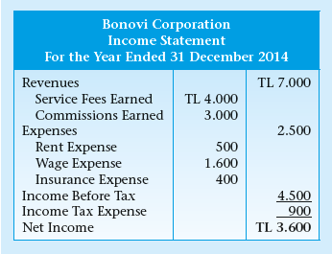
Example of an Income Statement

Slide 18
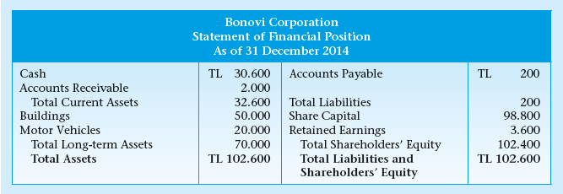
Statement of Financial Position
(Balance Sheet)
Net income retained in the business

Slide 19
Statement of Cash Flows
deals with cash in-flows and out-flows company resulting from operating, financing and investing activities for a specific period
presents information regarding the goal of liquidity

Slide 20
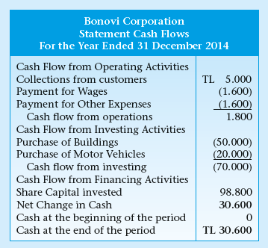
Statement of Cash Flows

Slide 21
Statement of Changes in Equity
summarizes the transactions that affect the shareholders’ equity in a given period
increases in the share capital or payments of dividends to shareholders during the period are presented

Slide 22
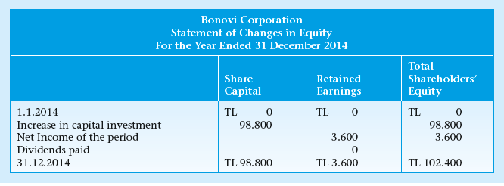
Statement of Changes in Equity

Slide 23
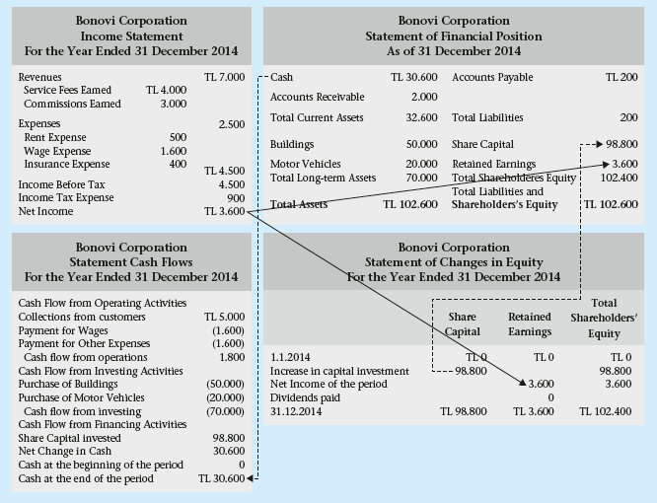

Slide 24
Auditing and Auditors’ Opinion
Independent audit of financial statements:
  the examination of the financial statements, accounting system and internal controls, and the accounting records of a company
purpose of an independent audit is to express an opinion on the financial statements-
  whether they are prepared in accordance with the generally accepted accounting principles
  whether they fairly present the financial position of the company
auditors’ report implies that the financial statements are free of material misstatements

Slide 25
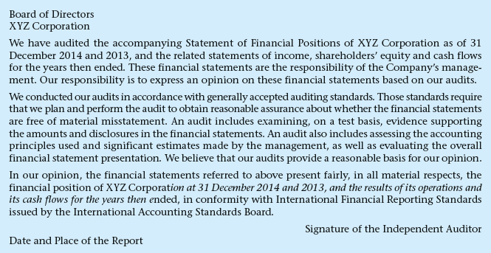

Slide 26
Regulatory Bodies
National
  Public Oversight, Accounting and Auditing Standards Authority
  Capital Markets Board (CMB)
  Ministry of Finance
  TURMOB (Union of Chambers of Certified Public Accountants of Turkey)
International
  International Federation of Accountants
  International Accounting Standards Board- International Financial Reporting Standards (IFRS)
  Financial Accounting Standards Board (FASB)
  Federation of European Accountants (FEA)

Slide 27
Development of Accounting
commercial transaction records - 3600 BC
first known formal treatment of accounting - Fra Luca Bartolomeo de Pacioli- in 1494- Summa de arithmetica, geometrica, proportioni et proportionalita
19th century – distinction between creditors and owners - national accounting standards
early 20th century - standardization of financial reports
end of the 20th century, these developments had resulted in the global standardization of accounting standards, and in the beginning of the 21st century, the International Financial Reporting Standards were issued

Slide 28
Development of Accounting in Turkey
Commercial Code of 1850 - translation of the French Commercial Code
a second Commercial Code was enacted by Law number 826, in 1926- based on the German commerce and company laws that controlled the accounting rules
1950s on- American expertise has been utilized and the Turkish economic system - heavily influenced by the American system
Istanbul Stock Exchange (ISE) came out in 1984; full operations started in 1986, and it is still the only stock exchange in Turkey. The foundation of the Capital Markets Board (CMB) and the Istanbul stock exchange, and the increase in foreign investments
The first set of financial accounting standards was developed in January 1989 by the CMB, to be effective for the fiscal years that started on or after January 1, 1989
The Ministry published the committee’s report in a communiqué on 26 December 1992, establishing the principles and the uniform chart of accounts to be in effect starting 1 January 1994
Turkish Accounting Standards Board (TASB - IFRS), and has issued thirty-one accounting standards and twelve financial reporting standards, as of the time this book went to press.
26 September 2011 the TASB is dissolved and Public Oversight, Accounting and Auditing Standards Authority is formed

Slide 29
Accounting Profession in Turkey
Certified Public Accountant (CPA)
Sworn-in Certified Public Accountant (Sworn-in CPA)

Slide 30
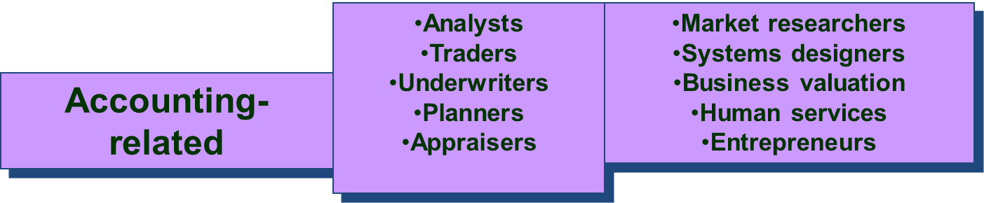
Career Opportunities in Accounting
Public Service and Taxation
Financial
Managerial
Preparation
Analysis
Auditing
Regulatory
Consulting
Planning
General accounting
Cost accounting
Budgeting
Internal auditing
Consulting
Controller
Treasurer
Strategy
Planning
Regulatory
Investigations
Consulting
Enforcement
Treasury
Ministries
Legal services

Slide 31
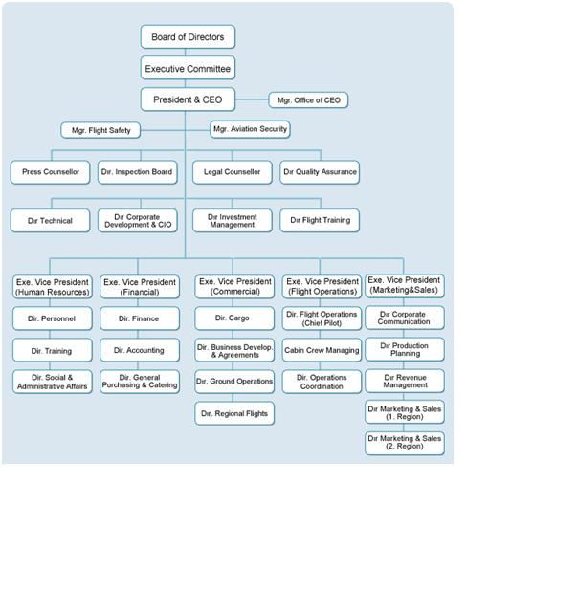
Corporate Organization Chart

Slide 32
Welcome to the world of accounting…………………

